Slide 1

BMLT and YAP
Volunteer Region of Narcotics Anonymous

Slide 2
Basic Meeting List Toolbox
Created over 10 years ago by a Member from New York
Slow to grow
Some of our areas started using the BMLT 6+ yrs ago
It expanded to all areas in 2017

Slide 3
BMLT PROS
Easily maintained, updated, syncs with NAWS
UPDATE ONE TIME
Search for meetings
on the website,
on your phone,
using BMLT apps
and YAP

Slide 4
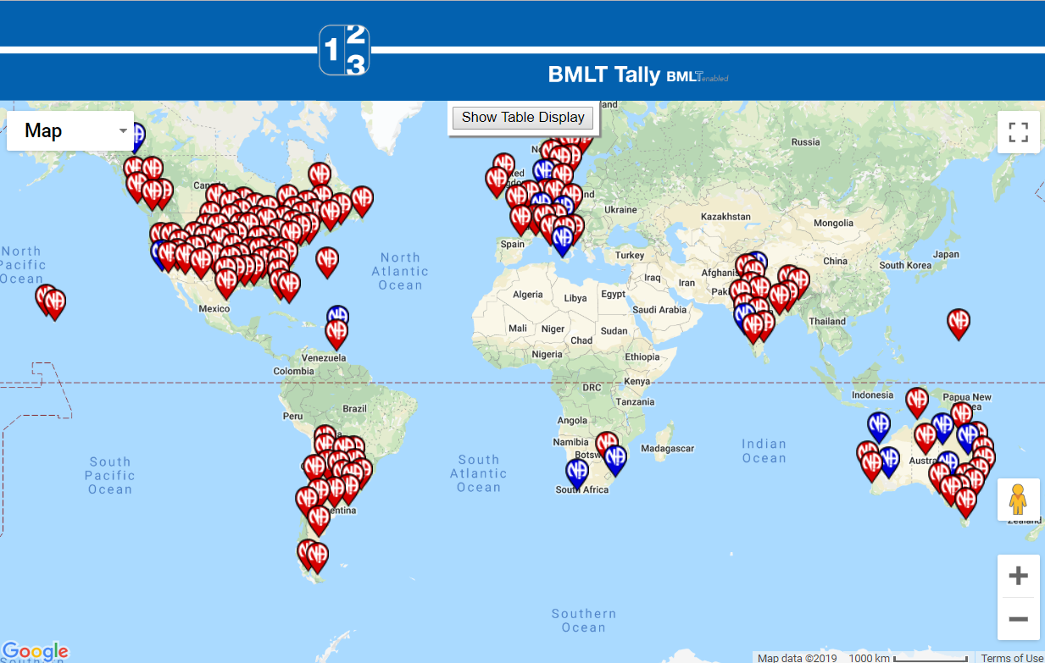
Currently 1/3 of meetings worldwide use the BMLT
See bmlt.app/tally

Slide 5
Regional Meeting list: natennessee.org/meetings
Searchable Map… place cursor in meeting location
Search by zip code
See distance to the meeting from you
How many meetings/groups in the service body.

Slide 6
natennessee.or/meetings-by-area
List of counties each area serves
Links to BMLT meeting list for each area
Includes Area
Helpline Number
Website URL
List of Meetings
Events/Calendar page

Slide 7
VRSC areas using BMLT on their websites…
nanashville.org
namwt.org
na-wt.org
etror.org
naknoxville.org
hotascna.org
Maybe one day the entire region will change over to the BMLT…

Slide 8
Another great benefit…
No more keeping a separate paper meeting list updated…
http://www.naknoxville.org/?current-meeting-list=1
https://meetinglist.natennessee.org/na-wt/?current-meeting-list=1
http://nanashville.org/?current-meeting-list=1
https://meetinglist.natennessee.org/etror/?current-meeting-list=1

Slide 9
YAP, VRSC Helpline
901-350-5030
A platform connected to the BMLT
TEXT or CALL
When calling
Enter 1 to talk to someone (redirects to area helplines)
2 – search for meetings
3 – listen to JFT

Slide 10
YAP, VRSC Helpline
901-350-5030
When texting…
Enter zip code
TAP TO LOAD PREVIEW
TAP LINK
MEETINGS WITH MAP APPEAR
Enter JFT for the Just for Today

Slide 11
THE BMLT is FREE
There’s a small charge for YAP for the region… $10 every couple of months. YAP uses a program called Twilio.
Twilio allows YAP to make and receive phone calls, send and receive text messages, and perform other communication functions using its web service.

